Slide 1

Project Topic: Wine Quality Tester
Submitted By: Akshay.C

Slide 2
Introduction
Data acquired from https://www.kaggle.com/uciml/red-wine-quality-cortez-et-al-2009 from Kaggle.
Datasets are related to red and white variants of the Portuguese "Vinho Verde" wine and data is obtained from different chemical tests conducted on the samples.
Inspiration : Use detailed analysis to determine which physiochemical properties make a wine 'good'! And make a machine learning model for making predictions.

Slide 3
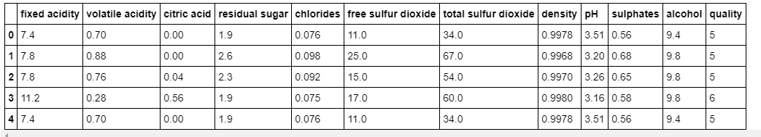
Data exploration

Slide 4
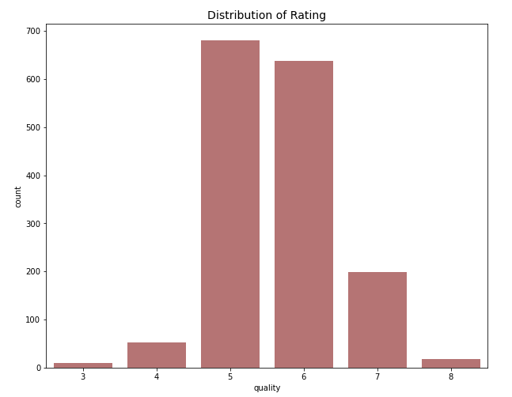
Methodology

Slide 5
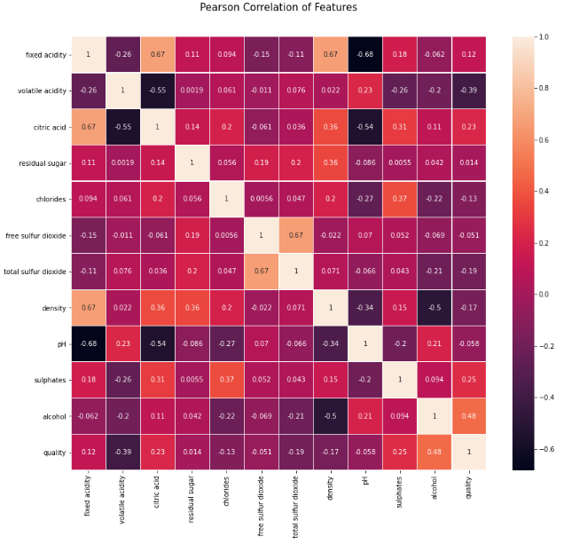
Correlation Matrix

Slide 6
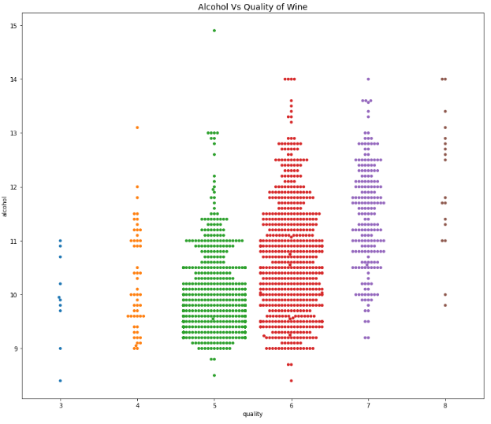
Impact of Alcohol on quality

Slide 7
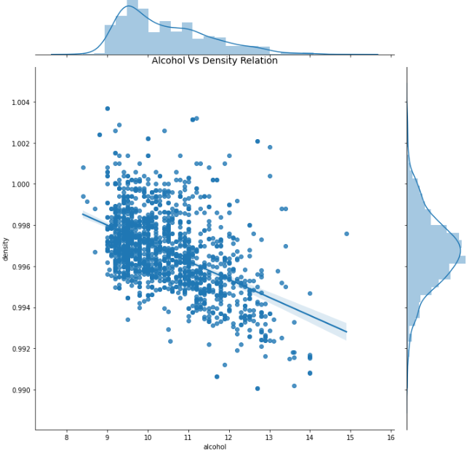
Alcohol vs Density Relation

Slide 8
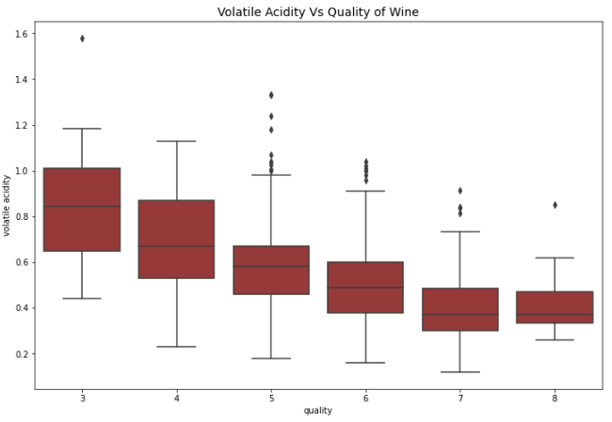
Volatile Acidity Vs Quality

Slide 9
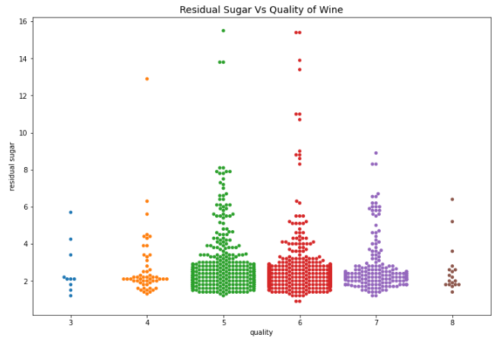
Residual Sugar

Slide 10
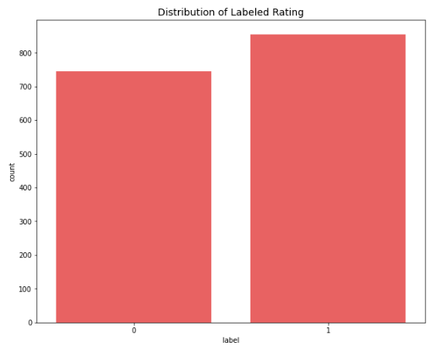
Feature Creation and its Distribution

Slide 11
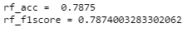
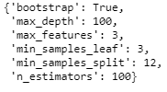
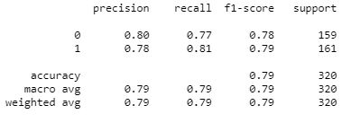
Model Development and evaluation
Random Forest Classifier Model Accuracy and F1 score
Best Hyper Parameters Classification Report

Slide 12
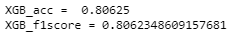
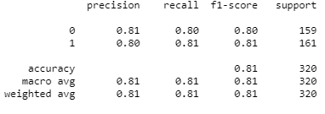
XGBoost Model
Best Hyper Parameters
Accuracy and F1 score
Classification Report

Slide 13
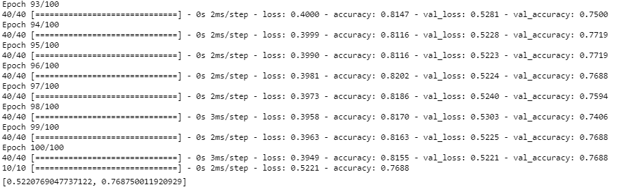
Keras Deeplearning Dense Network

Slide 14
Result
XGBoost model outperforms other models
Alcohol content in wine and Volatile Acidity have major impact in the prediction of quality.
Residual Sugar content in the wine does not impact the quality.

Slide 15
Conclusion
The best model ie: the XGB model has been is trained on full dataset.
The trained model is saved and is ready to be deployed into a web application for predicting what type of wine should a particular firm should produce.
This web application will be very useful in the success of Business firms who are investing in the production of wine.

Slide 16
Thank You !

